Slide 1

PENETRATION TESTING

Slide 2
THE LABORATORY

Slide 3
THE LABORATORY
How can we build a protected environment where we can perform our simulations?
The answer is: we can use a emulator.

Slide 4
RELEVANT CONCEPT
This consists in simultaneously executing multiple virtual machines and, therefore, more operating systems within the same physical system.

Slide 5
VIRTUALIZATION

Slide 6
VIRTUALIZATION
With VIRTUALIZATION you will be able to run several operating systems at the same time inside your PC. The only limit are the resources (CPU, RAM, disk) of your system.

Slide 7
VIRTUALIZATION
Steps to follow:
Download a particular software called hypervisor.
Collect the .iso images of the operating systems you want to install.
Access the software.
Start the virtual machine creation process.

Slide 8
VIRTUALIZATION
Steps to follow:
Create and boot this virtual machine.
Proceed with the installation of the desired operating system.
Use the virtual machine you have just created.

Slide 9
HYPERVISOR
The hypervisor is a software that allows you to run virtual machines inside your physical PC.

Slide 10
HYPERVISOR
You can choose among several versions. Some of them are free, while others require a subscription fee. Here are the most common ones:
VMware Workstation (proprietary, paid version, 30-days free trial).
VMware Player (proprietary, free).
Oracle Virtualbox (free, open source).
QEMU (free, open source)

Slide 11
HYPERVISOR
Here we we mainly focus on Virtualbox, QEMU and Docker (actually linux containers - LXC)

Slide 12
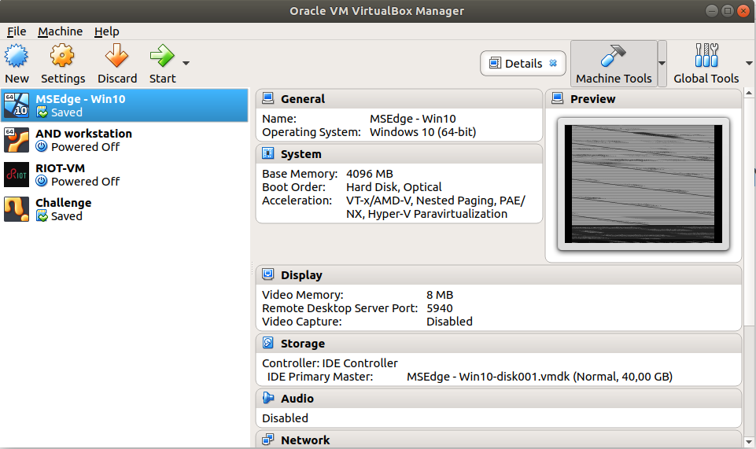
VIRTUALBOX

Slide 13
HYPERVISOR
In order to create your virtual machines, you need an image of the operating system you want to install (.iso format). For the lab we are building, you might want to have a look to:
Kali Linux;
Windows 7;
Windows 10.

Slide 14
HYPERVISOR
Kali Linux is a full-fledged attacking machine, we will use many tools that are natively supported by Kali.
Windows machines may be interesting targets

Slide 15
CREATION OF VIRTUAL MACHINES

Slide 16
CREATION OF VIRTUAL MACHINES
Just click “New” and follow the instructions
The configuration procedure will prepare the virtual hardware
Then you need to provide a OS disk image
You can also import existing VMs
To distinguish between the OS running an hypervisor and the OS running inside it we call them host and guest, respectively

Slide 17
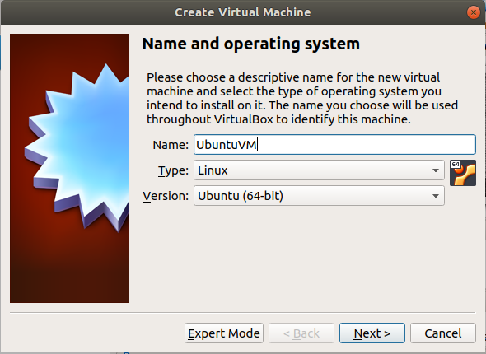
CREATION OF VIRTUAL MACHINES

Slide 18
CREATION OF VIRTUAL MACHINES
Pay attention to the quantity of resources (especially RAM) you are allocating
This amount depends on the RAM available on your PC, and you should try not to allocate it all
After creating some VMs we can configure them and (to a certain extent) even their hardware
More importantly, we can configure their network settings

Slide 19
NETWORK MANAGEMENT

Slide 20
NETWORK MANAGEMENT
Managing the network correctly is extremely important in certain cases.
We are not going to see this into detail, but Virtualbox allows you to configure a network of VMs

Slide 21
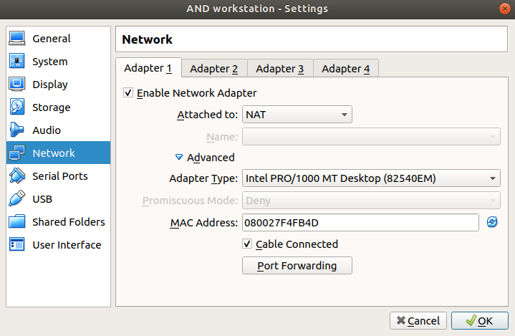
NETWORK MANAGEMENT
In Virtualbox, we can use different types of networks

Slide 22
NETWORK MANAGEMENT
Types of networks (attach to)
Not attached: the VM has an interface but it is isolated from the network (e.g., cable unplugged)
NAT: Virtualbox uses its internal NAT and DHCP services to connect VM and physical interface in a dedicated manner. VM can access the network, but no guest-host and guest-guest connection
NAT network: same as before, but a single NAT and DHCP are instantiated for multiple guests in the same network. Guest-guest is allowed

Slide 23
NETWORK MANAGEMENT
Types of networks (attach to)
Bridged: the VM adapter is mapped to the physical interface which receives an alias IP address for each bridged VM. The guest has direct access to the host network as if it was physically connected.
Internal network: A virtual switch connects the guest VMs and the DHCP service assigns IP addresses. The network is isolated (virtual subnet) unless one of the connected VMs is a router with another active interface. Otherwise, only guest-guest connections can occur

Slide 24
NETWORK MANAGEMENT
Types of networks (attach to)
Host-only: an internal network is connects the guest VMs and the host machine. The host connects through a virtual adapter (unrelated to the physical one). The internal network is isolated from the outside network. Yet, guest-host connections are allowed.

Slide 25
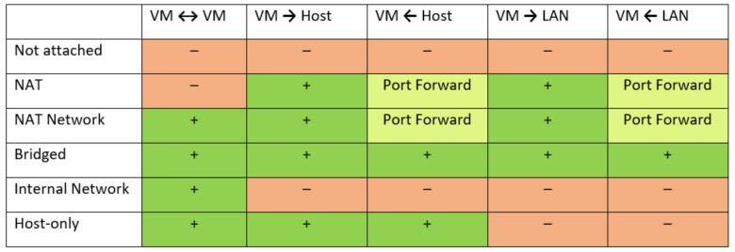
NETWORK MANAGEMENT
Virtualbox adapters summary
(source: https://www.nakivo.com/blog/virtualbox-network-setting-guide/)

Slide 26
NETWORK MANAGEMENT
To create a NAT network go to "File -> Preferences -> Network" and create a new network.

Slide 27
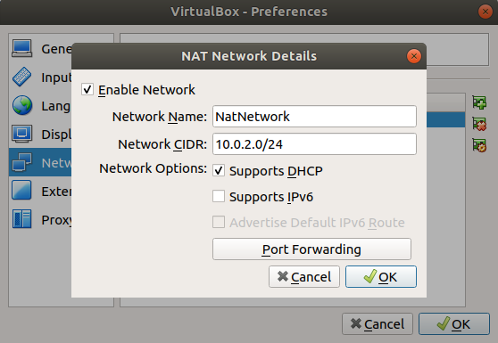
NETWORK MANAGEMENT

Slide 28
VIRTUALIZATION AND GNS3

Slide 29
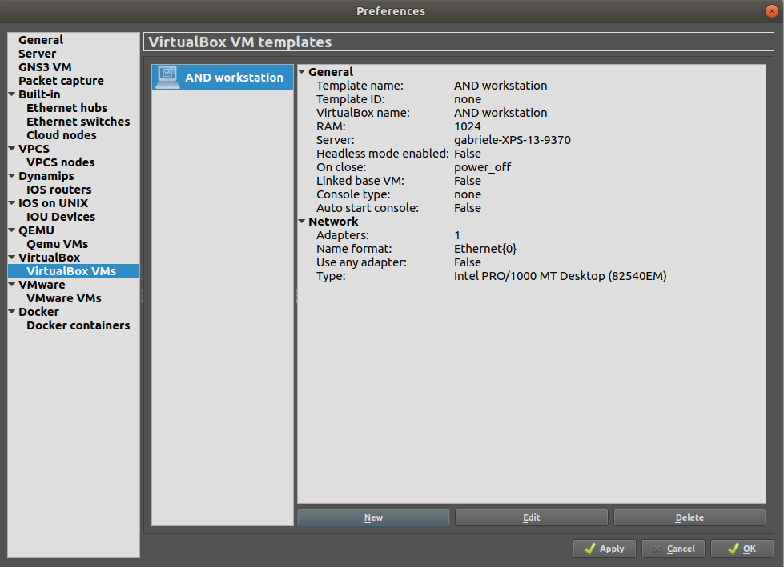
HYPERVISORS AND GNS3

Slide 30
HYPERVISORS AND GNS3
Several hypervisors are integrated in GNS3 (Virtualbox, QEMU, VMWare)
You can import your VMs or even create new ones directly in GNS3
Network configuration can be done from the GNS3 interface
However, using multiple hypervisors in the same topology is an issue
They consume resources and may be incompatible (e.g., both QEMU and Virtualbox use hardware acceleration)
If possible, let use docker!

Slide 31
LINUX CONTAINERS
Docker is a popular (not the only one) system based on linux containers (LXC)
A linux container is a process that runs inside a sandbox, directly on host
Each container only needs its runtime support (e.g., libraries)
No guest OS, no hypervisor = higher efficiency!

Slide 32
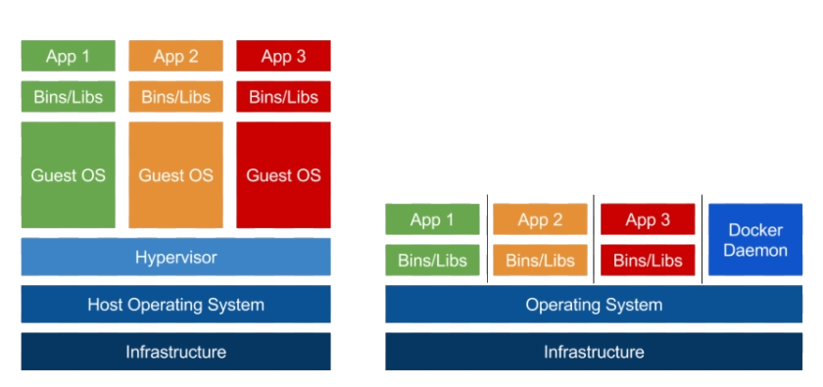
VIRTUALIZATION VS CONTAINERIZATION

Slide 33
LABORATORY TOPOLOGY

Slide 34
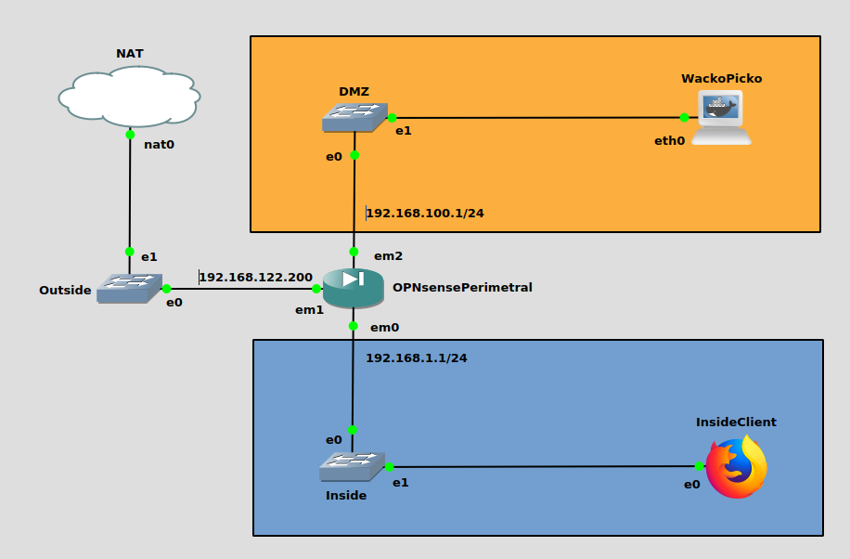
TOPOLOGY

Slide 35
TOPOLOGY
Internal network: this is the target infrastructure for our pentesting activities

Slide 36
TOPOLOGY
DMZ: services should be visible from outside. We can use static IPs + DHCP (2 intervals)
Perimetral firewall: OPNsense firewall that we will configure according to this policy:
Inside -> Outside
DMZ <-> Outside
Inside <-> DMZ
Also, we create virtual IPs for DMZ servers
Inside: this segment should not be accessed from outside
We can use DHCP here

Slide 37
TOPOLOGY
NAT node: provides connectivity to the host machine (and to the outside network)
DMZ machines: we will target them (will change over time)
Inside clients: we will use them for configurations and as targets (may change over time)
Outside clients that we might want to use go here

Slide 38
VIRTUAL LABORATORY
The attacking machine must be connected to the outside network.
This gives use two possibilities
Create an external client (e.g. a Kali linux), but this can degrade the performances;
Use our own host device! We are connected through the NAT node anyway
I suggest to go for 2. Also because all the tools we are going to see are multi-platform (so you can use Windows if you feel more confident)
Yet, you can go for 1 if your machine supports it.

